Slide 1
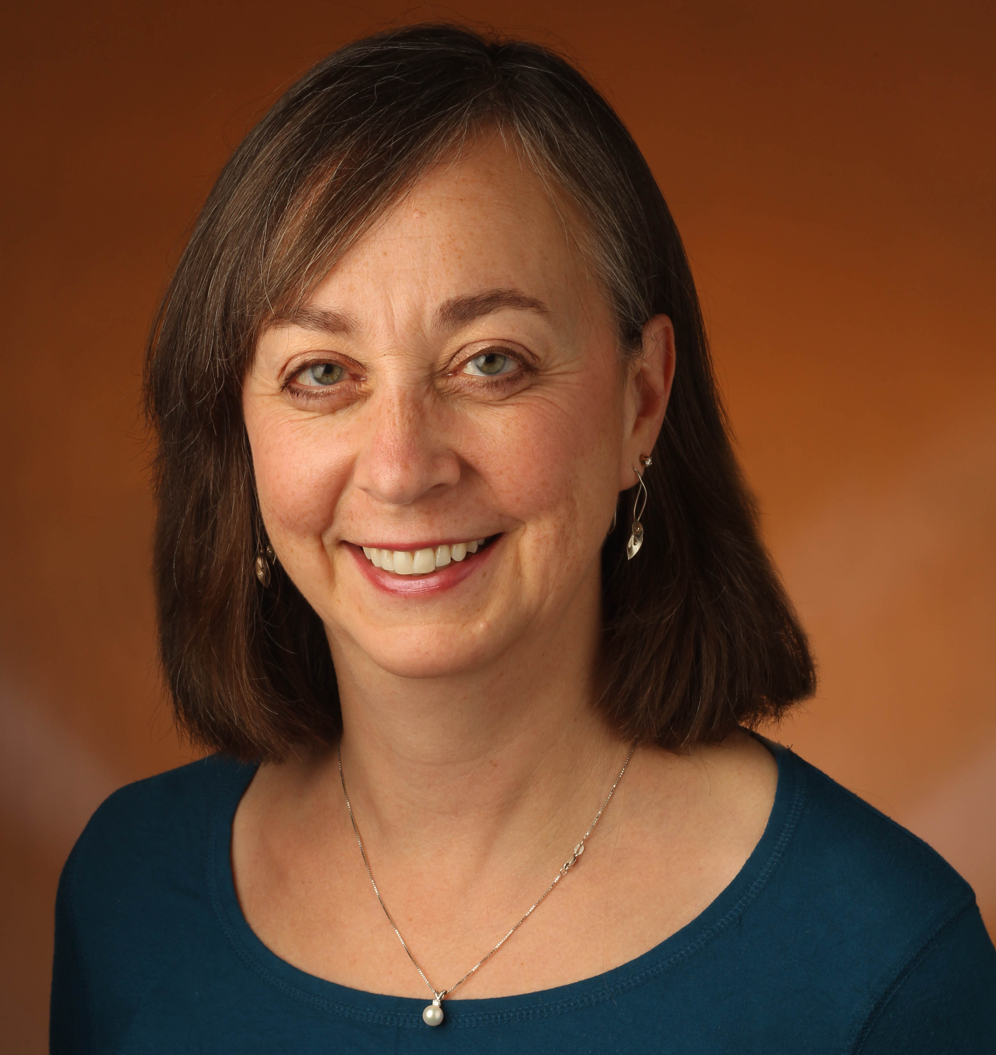
This fantasy title empowers as much as it entertains. . . This subversive hero’s quest champions the concepts of gender equality and embracing differences while also delivering an engrossing, laugh-filled adventure.
— SLJ
Marabel and the Book of Fate
Little, Brown and Company
Tracy Barrett

Slide 2
Author Tracy Barrett
Freefall Summer
Charlesbridge TEEN
Tracy Barrett in freefall

